Slide 1

过关测试卷
模块七 第二章 测试卷

Slide 2
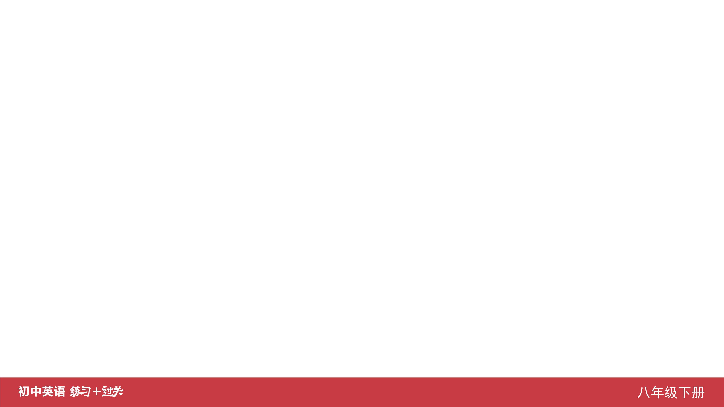
Ⅰ. 听力
1-5 ____________
6-10 ____________
11-15 ____________
16 ____________
17 ____________
18 ____________
19 ____________
20 ____________
ACBAC
BCCAA
BCACB
America
three/3
food
new
expensive

Slide 3
Ⅱ. 选择填空
21-25 ____________
26-30 ____________
31-35 ____________
CAACA
BCBAC
ABBCC

Slide 4
Ⅲ. 完形填空
36-40 ____________
41-45 ____________
ACCBA
BBCAB

Slide 5
Ⅳ. 阅读理解
46-50 ____________
51-55 ____________
56-60 ____________
61-65 ____________
66-70 ____________
CACDB
DBCDB
BACCA
CBCDA
CDAEB

Slide 6
Ⅴ. 情景交际
71. __________________________________________
__________________________________________
72. __________________________________________ 73. __________________________________________
74. __________________________________________
75. __________________________________________ __________________________________________
Tony, could you tell me if/whether you will go to Beijing tomorrow?
Would you mind teaching me English?
Please help yourself to some fish, Lisa.
I’m not sure when Sally will come.
Who arrived at/got to/came to school earliest this morning?

Slide 7
Ⅵ. 看图写话
76. ____________________________________________
77. ____________________________________________
78. ____________________________________________
____________________________________________
79. ____________________________________________
80. ____________________________________________
The girl/She cut the pears into pieces.
The boy/He had (a bowl of) noodles for supper.
Dumplings are Jack’s favorite Chinese food./
Jack’s favorite Chinese food is jiaozi.
The boy/He is putting some honey on the bread now.
It’s polite to eat up the food on your/the plate.

Slide 8
Ⅶ. 短文填空
special
invited
carefully
a
guests
81 ____________
82 ____________
83 ____________
84 ____________
85 ____________
86 ____________
87 ____________
88 ____________
89 ____________
90 ____________
began
but
car
believe
remember

Slide 9
Ⅷ. 书面表达
Dear Bruce,
I’d like to tell you how to cook scrambled eggs with tomatoes.
Yours,
Li Ping
It is very easy.
First, wash a tomato and cut it up, and beat two eggs. Next, put some oil in the pan, and add the beaten eggs. Fry it for a few minutes, and then put it into a bowl. After that, add some oil into the pan again and fry the tomato. After a moment, add some salt and sugar. Finally, add the cooked egg and fry it with the tomato. Now the scrambled eggs with tomato is ready. You can enjoy it.

Slide 10


